Slide 1

Python Operators
Arithmetic Operators
Comparison (Relational) Operators
Logical Operators
Bitwise Operators
Assignment Operators

Slide 2
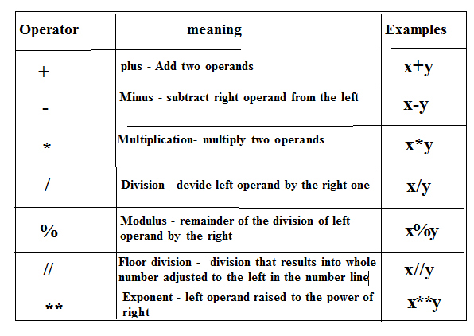
Arithmetic operator

Slide 3
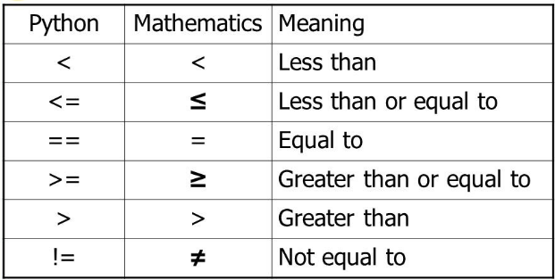
Comparison (Relational) Operators

Slide 4
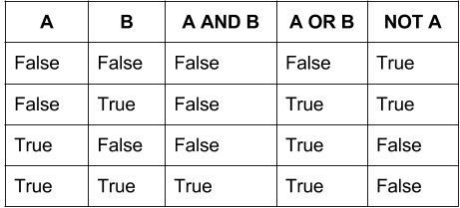
Logical Operators

Slide 5
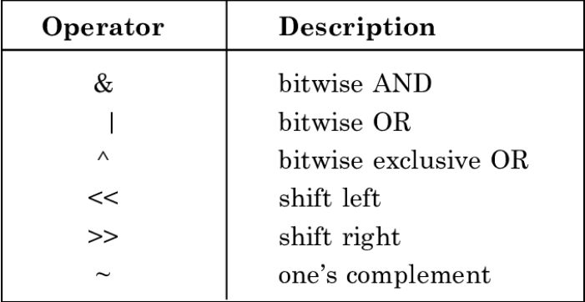
Bitwise Operators

Slide 6
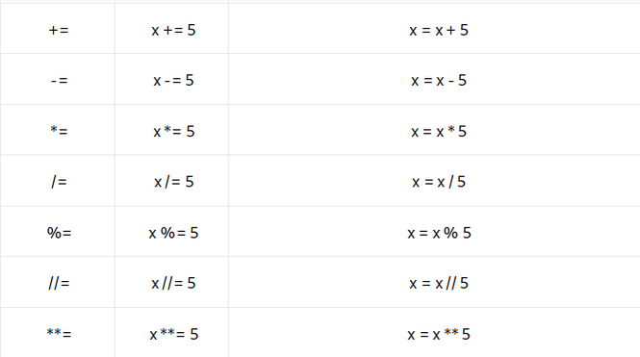
Assignment Operators

